Slide 1
Parallelizing Dijkstra’s Algorithm
By Mark, Taylor, Tim, and Zach

Slide 2
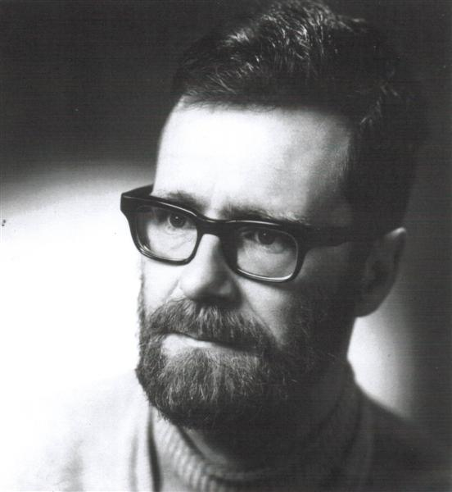
The Man, The Myth, The Legend

Slide 3
Brief overview of Dijkstra’s Algorithm
Finds the shortest path from the start node to every other node
Dijkstra’s algorithm has been used in the past to simplify city transportation routes and maps, by finding the quickest route from point A to point B
Dijkstra’s run time is O(M*N)
N = number of nodes
M = number of edges

Slide 4
Our version
We chose Dijkstra’s because we were familiar with the algorithm
We decided to find the shortest path from every node to every other node
Our run time is O(M*N^2), since Dijkstra’s is running N amount of times
Our program writes to a text file the shortest path from the current node to all other nodes

Slide 5
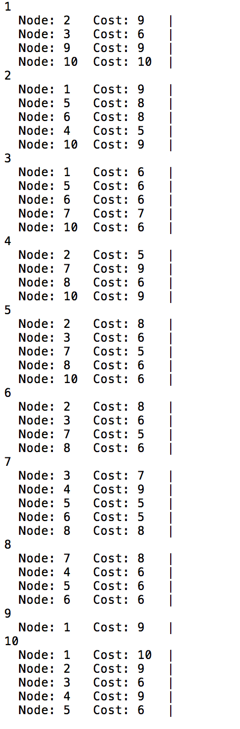
Input File

Slide 6
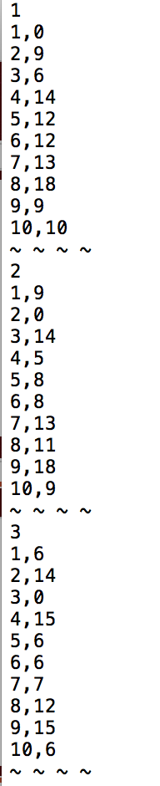
Output File

Slide 7
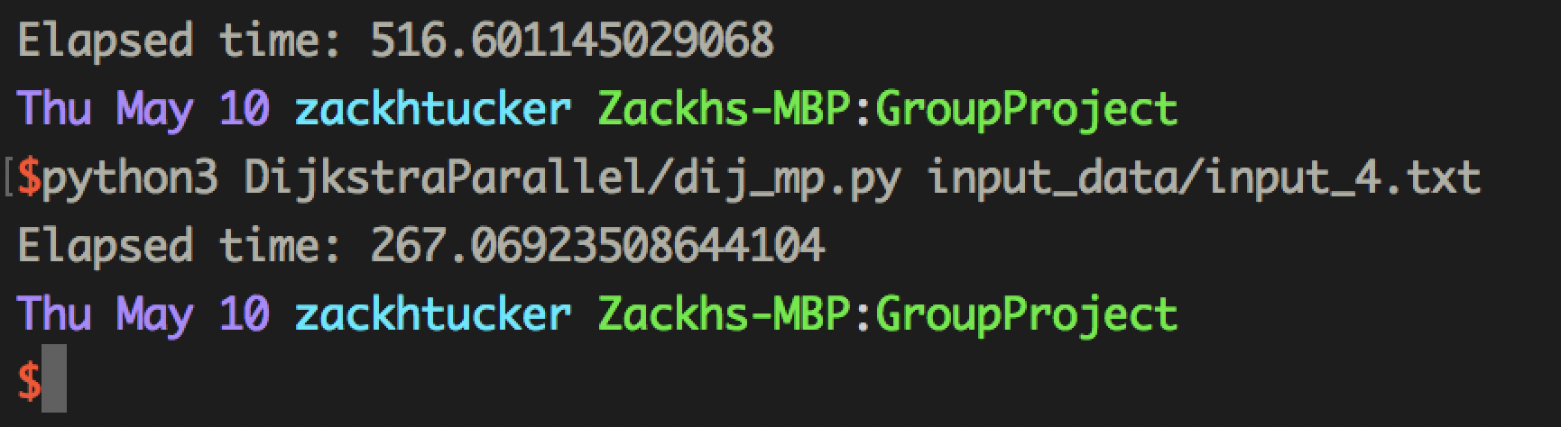
Screenshot of output

Slide 8
Benefits of Parallelization
Makes it faster
Allows for larger problem sets to be solved
Frees up more computing power to be used elsewhere

Slide 9
How we parallelized it
We are using Python multiprocessing to parallelize Dijkstra’s algorithm
N = number of nodes
K = number of processors
Each processor runs Dijkstra’s N / K amount of times, with a different start node each time

Slide 10
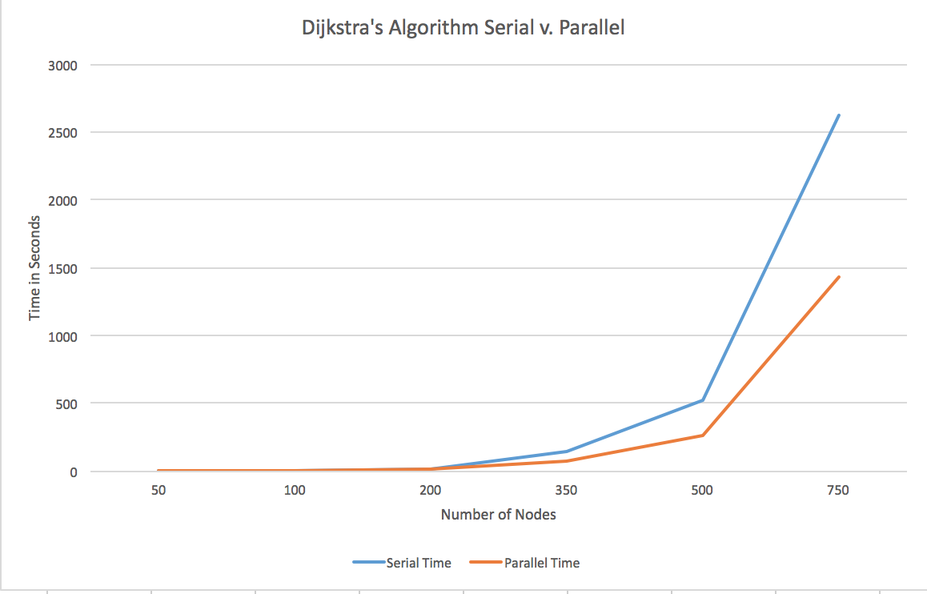
Results

Slide 11
Wrap up
FIN

